Slide 1

DATA VISUALIZATION
ONLINE RETAIL
GROUP 2:
Thi Minh Ngoc | Bui | CBU22CPWQ@cbu.ca
Kepler | Lau | CBU22BTWD@cbu.ca
Simarpreet | Kaur | CBU22CLBN@cbu.ca
Krina | Chiragkumar Patel | CBU22CGXL@cbu.ca
Rutvi | Dixitkumar Patel | CBU22CKJW@cbu.cA

Slide 2
contents
1
2
3
Data collection
Data
pre-processing
EDA & data storytelling
Summarize the information of the dataset
Cleaning the dataset
Exploring data analysis and visualizing the results

Slide 3
1
Data collection
Dataset: https://archive.ics.uci.edu/dataset/352/online+retail
INVOICE NO
Invoice date
stockcode
Unit price
description
Customer id
quantity
country

Slide 4
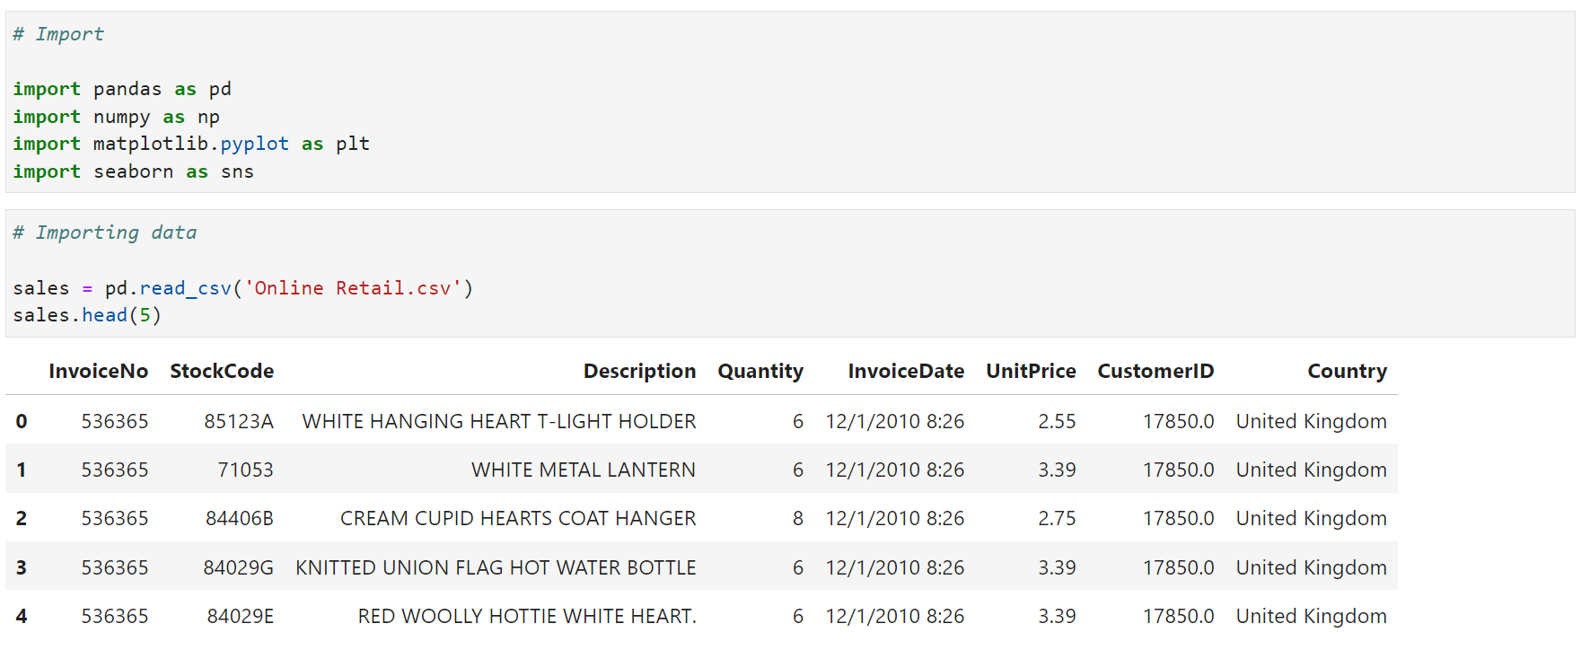
Data pre-processing
2
Importing some necessary libraries and the dataset into Python:

Slide 5
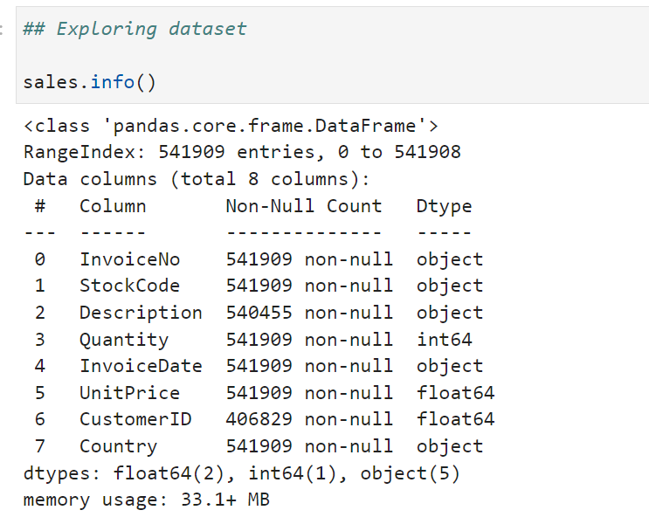
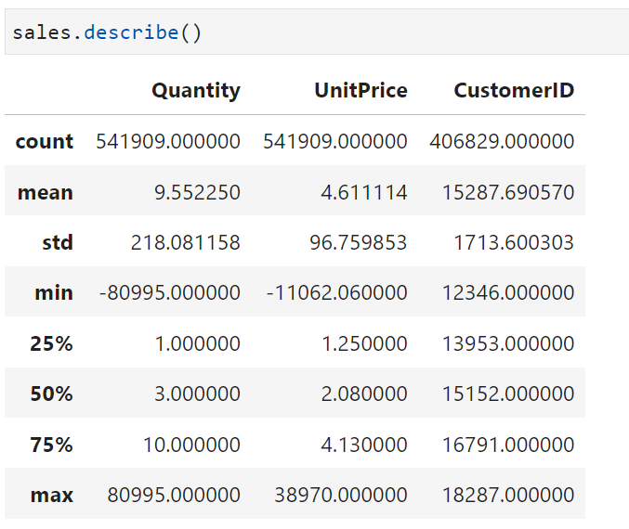
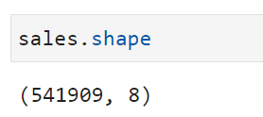
Data pre-processing
2
Understanding datatype, central tendency, and data shape:

Slide 6
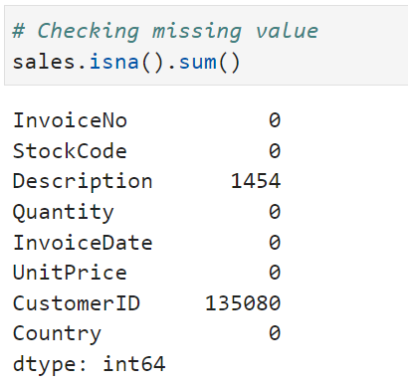
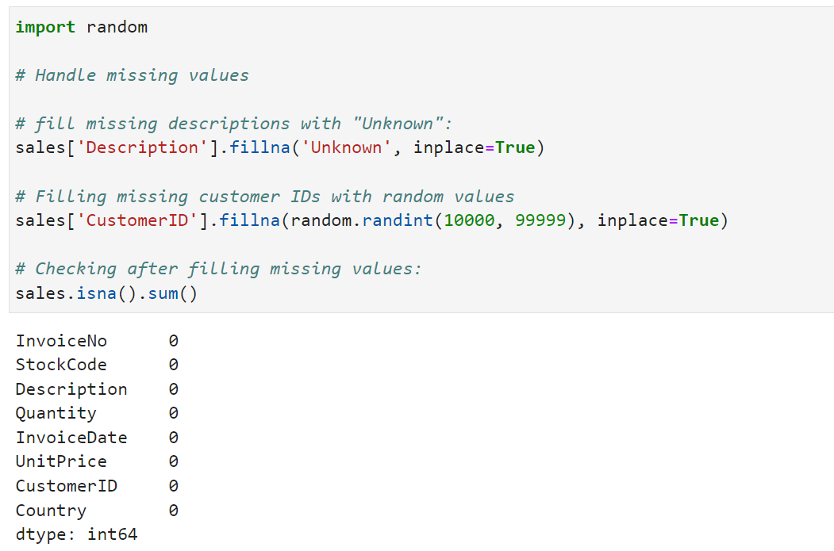
Data pre-processing
2
Checking missing values and filling in these missing values:
Notes:
The dataset has 1454 missing values in Description attribute, and 135080 missing values in CustomerID atrribute. We are going to handle these missing values by filling "Unknown" for Description attribute and random values for CustomerID

Slide 7
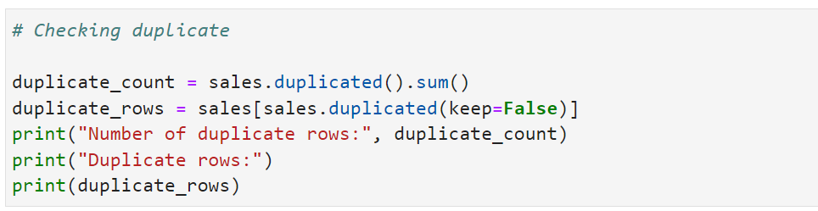
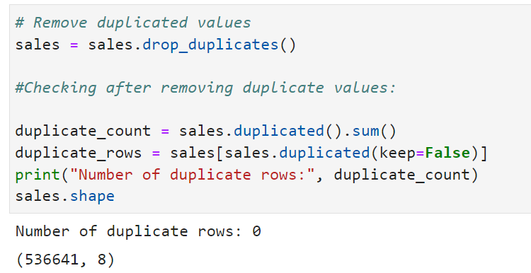
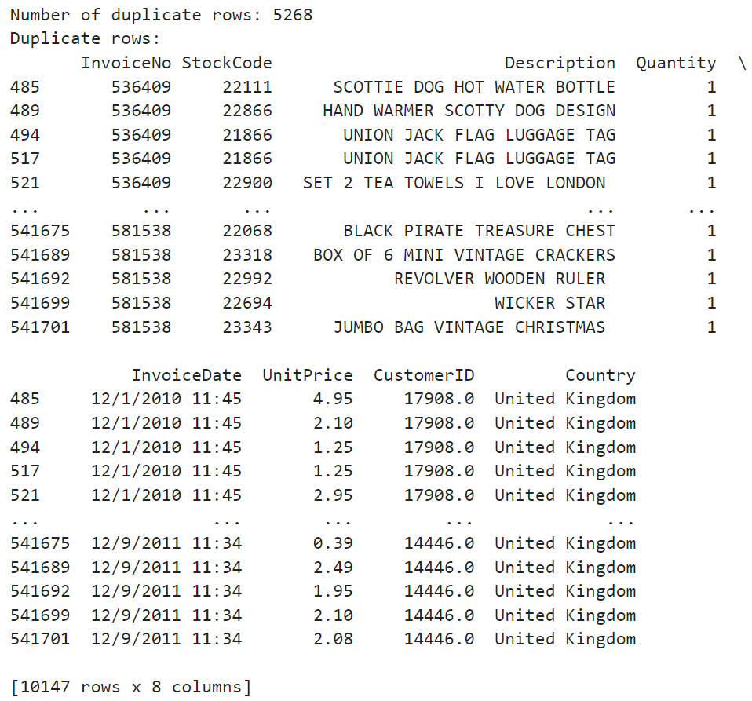
Data pre-processing
2
Checking duplicate values and removing:
Notes:
We have 5268 duplicate values in the dataset. We are going to solve it by remove all the duplicated values

Slide 8
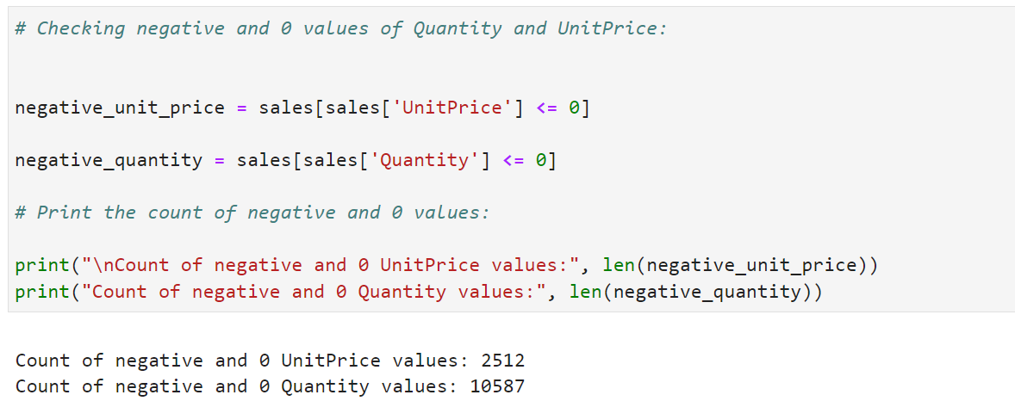
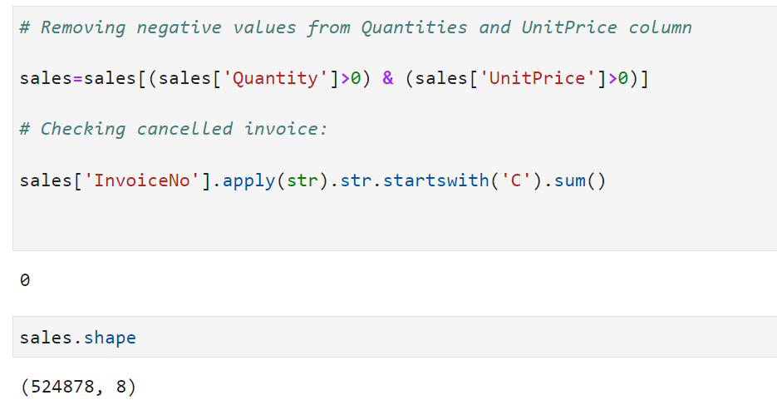

Data pre-processing
2
Checking negative and 0 values in Quantity and Unitprice and removing:
Notes:
We have many negative values for Quantities and Unitprice, leading to noisy data. Therefore, we are going to remove all of these data.
As we already removed negative values in Quantity and UnitPrice attributes, we no longer have canceled the invoice. Next, we are going to detect outliers.

Slide 9
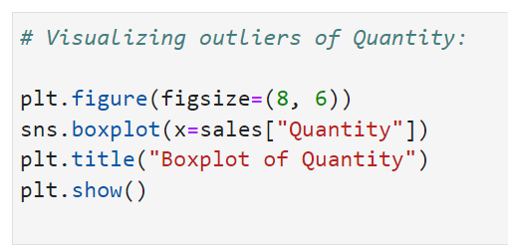
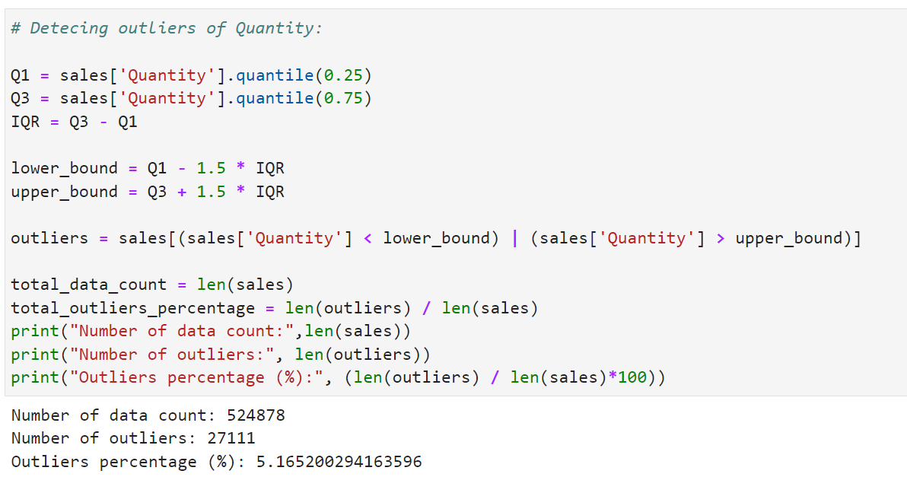
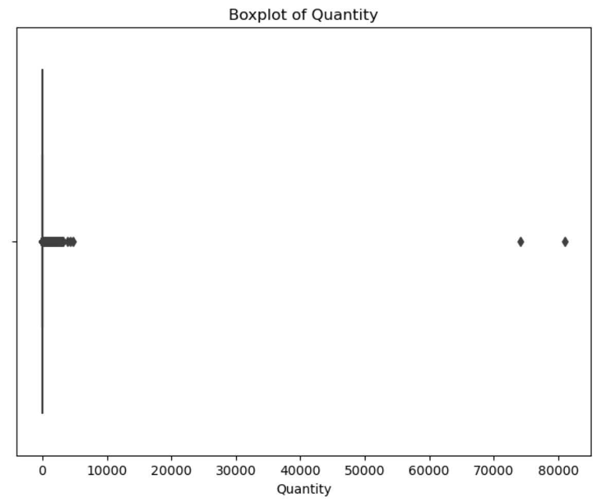
Data pre-processing
2
Detecting outliers of Quantity attribute:
Notes:
Quantity and UnitPrice are numeric attributes that should be checked outliers. However, the outliers from the UnitPrice attribute can be meaningful because the UnitPrice is fixed and it depends on which the product is. Besides, some products are cheap while some products can be expensive. Then we skip the detection for outliers of UnitPrice.
The number of outliers of Quantity is 27,111 which is around 5% of the dataset, we decided to remove these outliers because they cannot impact to whole data

Slide 10
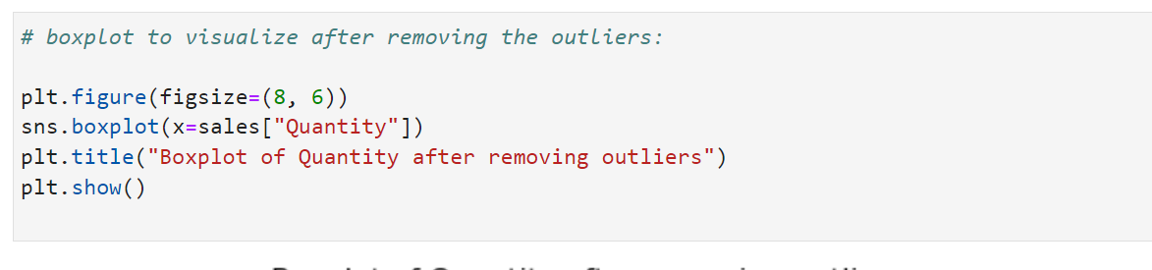
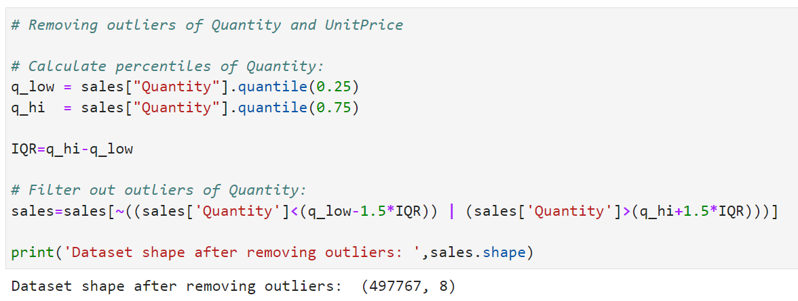
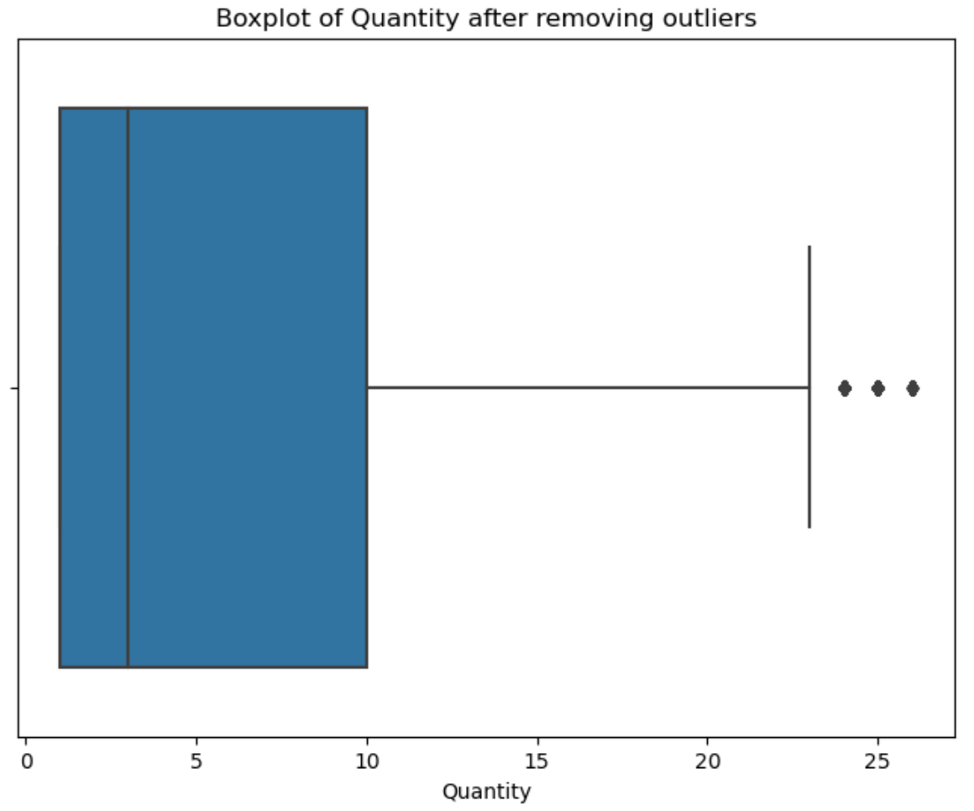
Data pre-processing
2
Removing outliers of Quantity attribute:
Notes:
We have already removed all of outliers of Quantity and UnitPrice attributes.

Slide 11
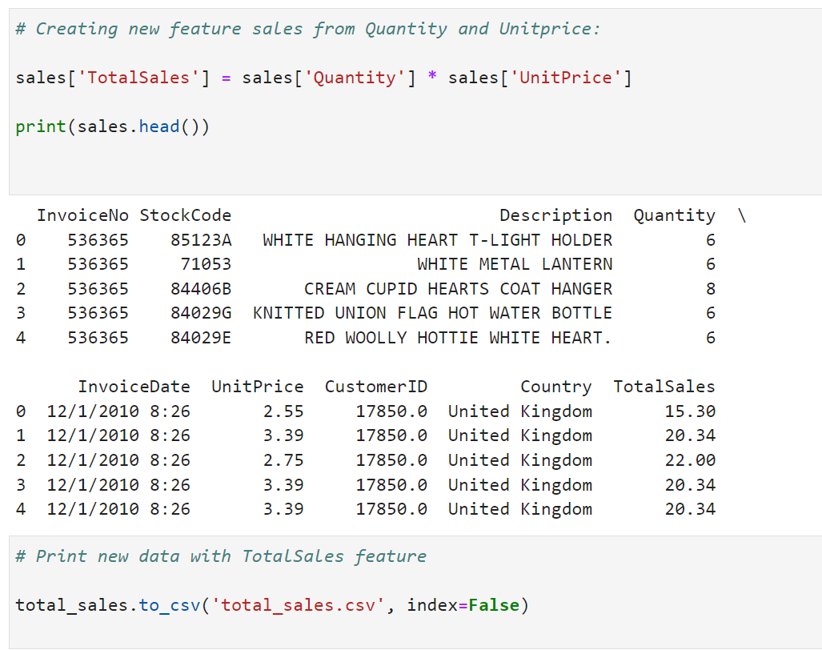
Data pre-processing
2
Creating new feature TotalSales:

Slide 12
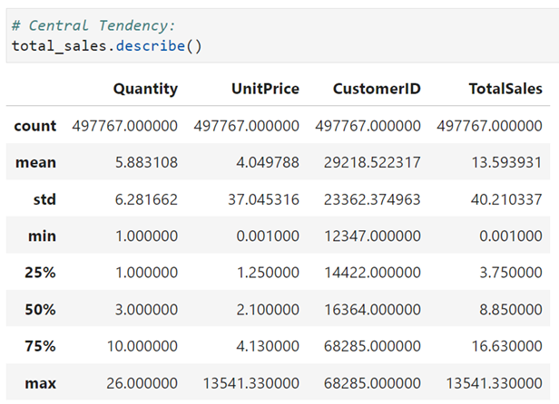
Data pre-processing
2
Understanding datatype, central tendency, and data shape of new dataset
Notes:
Our dataset is cleaned already. Then we are going to do EDA and data storytelling

Slide 13
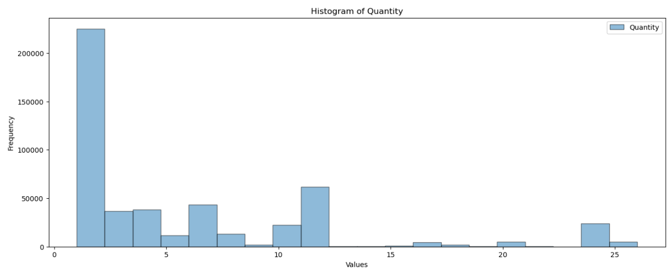
3
EDA & data storytelling
The distribution of Quantity after removing outliers:
→ Value 2 is highest while the orders are under 50000

Slide 14
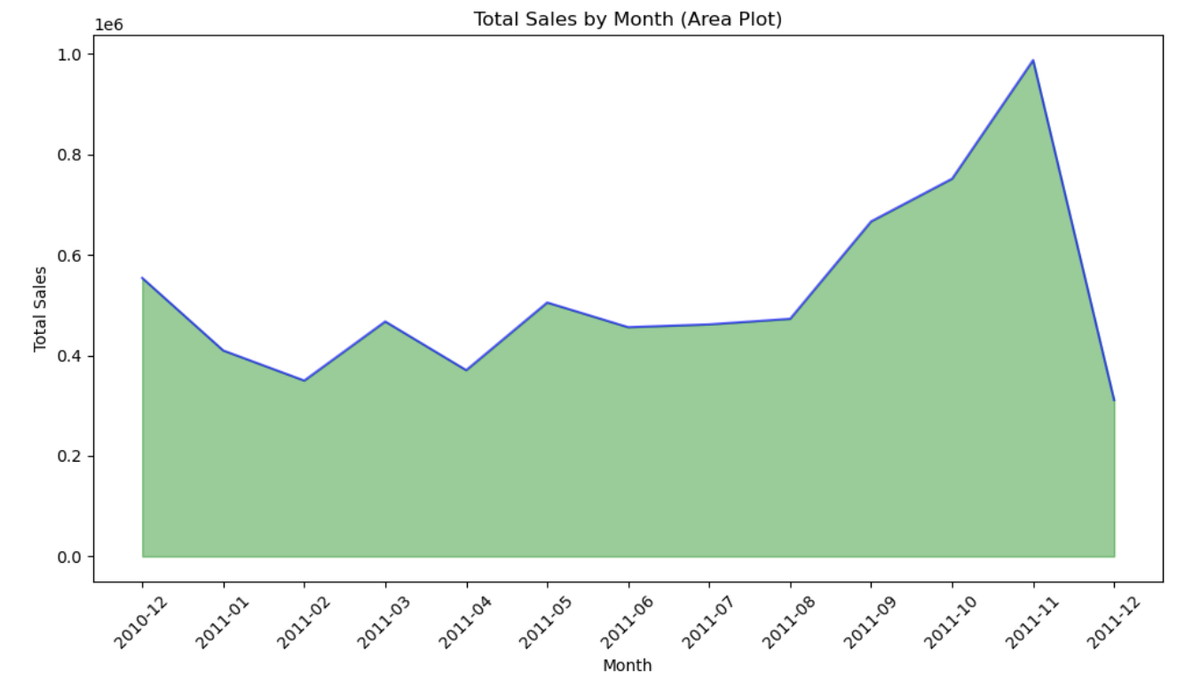
3
EDA & data storytelling
Total Sales by Month:
→ Peak sales period was November 2011

Slide 15
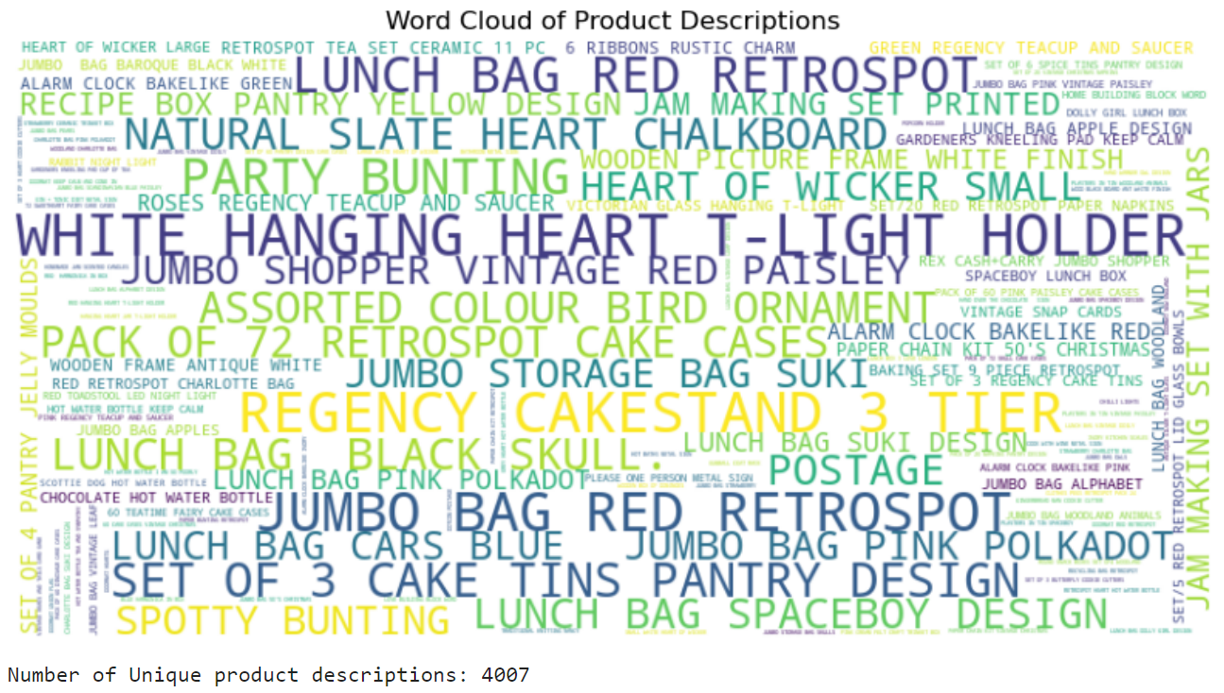
3
EDA & data storytelling
Word Cloud of Product Descriptions:
→ A Word Cloud generated from the Descriptions attribute visualizes the frequency of words in those descriptions, with the size of each word indicating its frequency

Slide 16
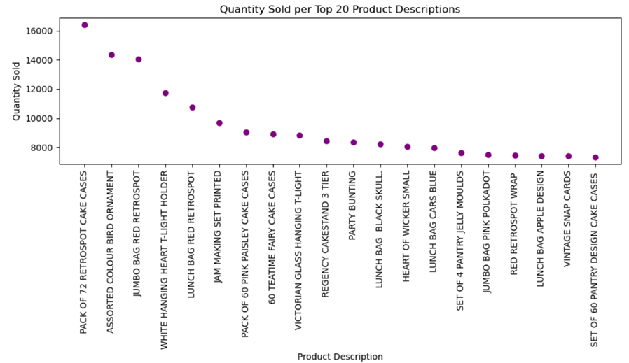
3
EDA & data storytelling
The Quantity sold per top 20 Product Description:
→ The top 5 products are over 10000 while the others are between 8000 and 1000

Slide 17
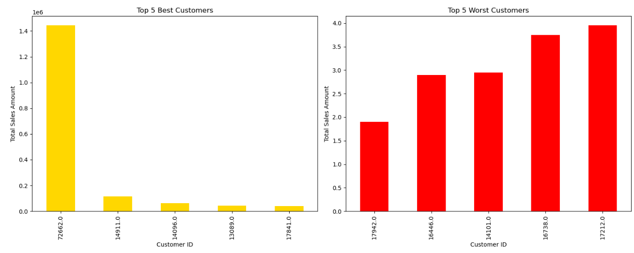
3
EDA & data storytelling
Total sales of the Top and Bottom 5 customers:
→ Customer ID 72662.0 has the highest Total Sales Amount while Customer ID 17942.0 has the lowest

Slide 18
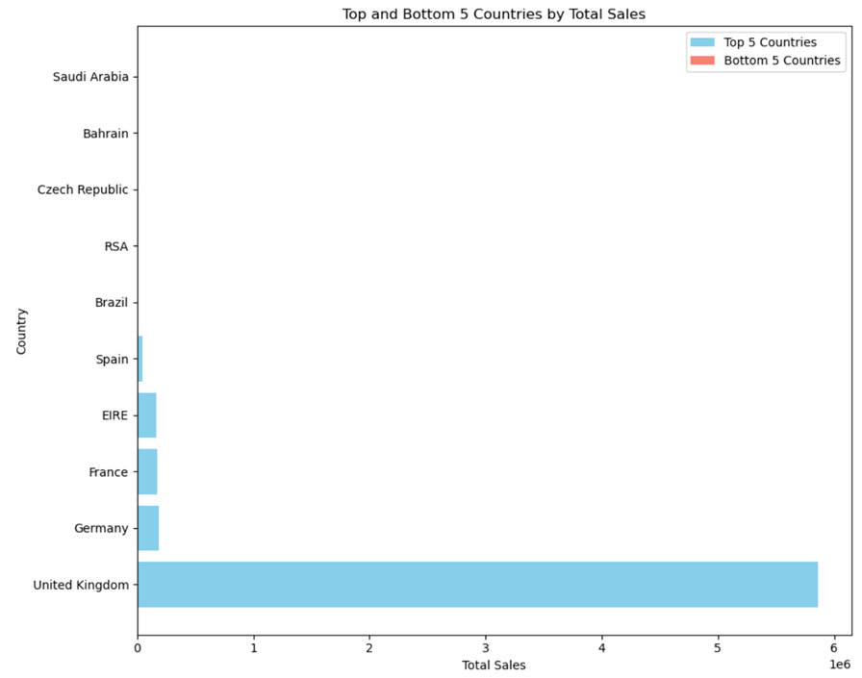
3
EDA & data storytelling
Total sales of the Top and Bottom 5 countries:
→ The United Kingdom has the highest Total Sales, while the sales of Saudi Arabia, Bahrain, the Czech Republic, and RSA are almost 0

Slide 19
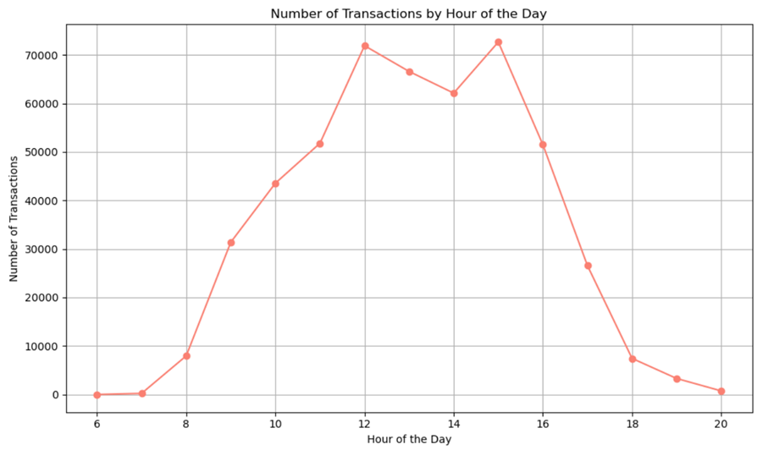
3
EDA & data storytelling
Number of Transactions by Hour of the Day:
→ 12 o’clock and 15 o’clock are the peak times of sales of the day.

Slide 20
conclusion
Learn and practice visualization that goes into the dataset by using Python
Learn the concept of storytelling and presentation to reach the audience
The outcomes of these visualizations help us deeply understand the dataset such as sales trends, and insight into every product, customer, or country
This information can be useful in decision-making to improve the business overall
Notes:
To conclude, during this project, we were able to learn…

Slide 21

THANKS FOR
listening

